Slide 1
EXCEPTION AND EXCEPTION HANDLING IN C#

Slide 2
WHAT IS EXCEPTION?
An exception is an event, which occurs during the execution of a program that disrupts the normal flow of the program's instructions.
In general, when a C# code encounters a situation that it cannot cope with, it raises an exception.

Slide 3
WHAT IS EXCEPTION?
An exception is a C# object that represents an error.
When a C# code raises an exception, it must either handle the exception immediately otherwise it terminates and quits.

Slide 4
WHAT IS EXCEPTION?
When an exception occur 3 things happen.
Program terminates or program crashes.
Ugly kind of error message is displayed that user can never ever understand.
Statements after exception will not be executed.

Slide 5
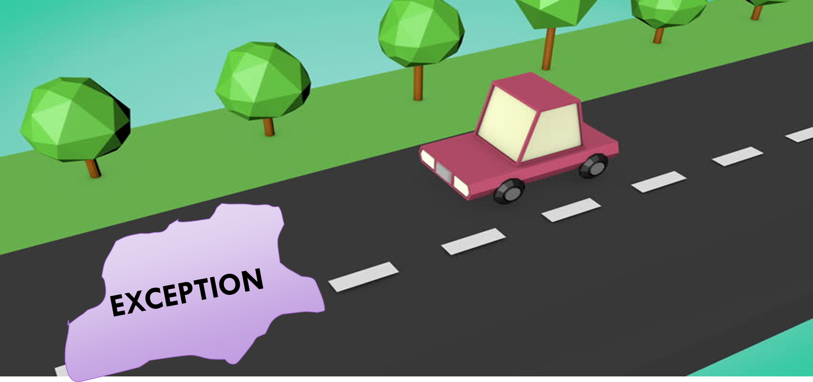
Exception flow in real life

Slide 6
WHAT IS EXCEPTION?
Exceptions are abnormal events that prevent a certain task from being completed successfully.
An exception is a problem that arises during the execution of a program.
A C# exception is a response to an exceptional circumstance that arises while a program is running, such as an attempt to divide by zero.

Slide 7
EXCEPTION HANDLING
The exception handling in java is one of the powerful mechanism to handle the runtime errors so that normal flow of the application can be maintained.

Slide 8
C# APPLICATION
{
c = a / b; //exception can occur here
}
{
// our exception handling code
}
C# DEFAULT CATCH MECHANISM
EXCEPTION OBJECT

Slide 9
we use exception handling. Let's take a scenario:
statement 1;
statement 2;
statement 3;
statement 4;
statement 5; //exception occurs
statement 6;
statement 7;
statement 8;
statement 9;
statement 10;

